Slide 1

Optimizing Air Travel: A Data-Driven Approach to Flight Delay Analysis and Prediction
Society of Business (Open Project)
Name: Mahesh Choudhary Enroll: 22117080 Branch: Mechanical

Slide 2
Introduction
Flight delays pose a critical operational challenge for the airline industry
Delays inconvenience passengers, incur financial losses for carriers, and affect subsequent flight schedules and airport operations.
The project aims to uncover key factors contributing to delays using historical flight data.
It will employ data visualization, statistical analysis, and machine-learning techniques to minimize future disruptions and improve operations.

Slide 3
Work Flow
Data Loading and cleaning
Exploratory analysis
Feature Selection
Model Development
Hyperparameter Tuning
Interpretability
Model Evaluation

Slide 4
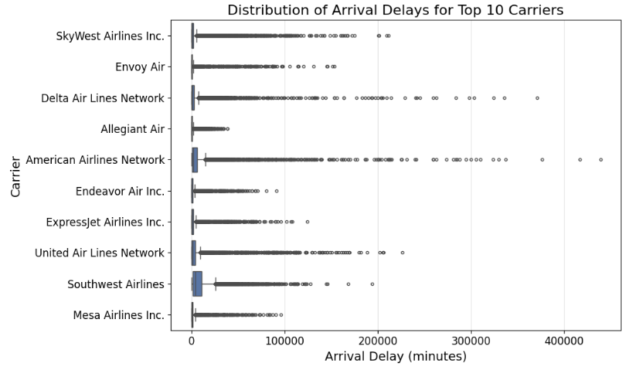
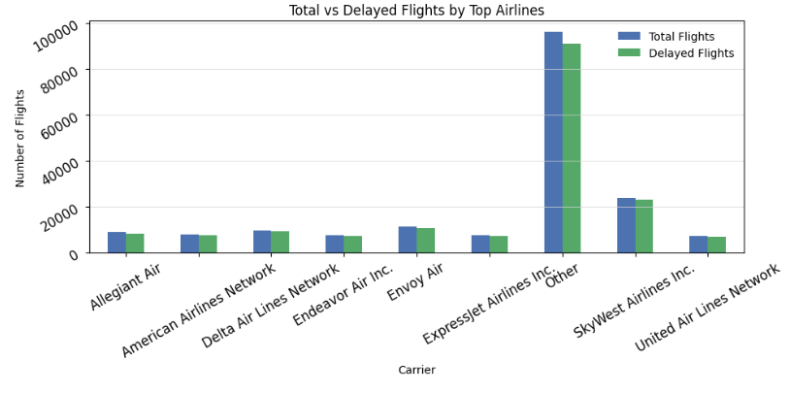
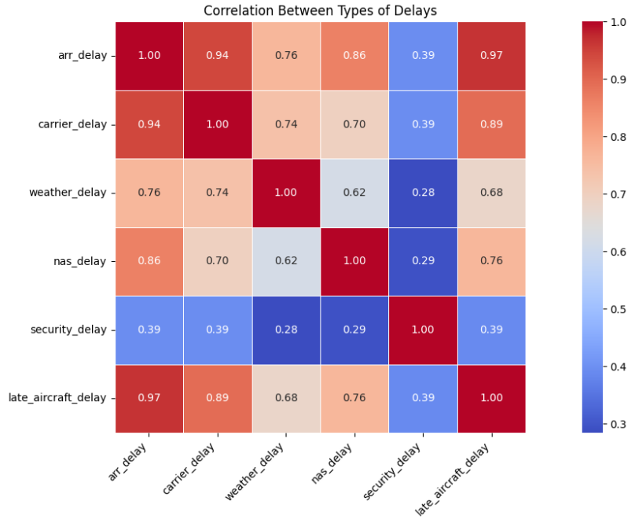
Exploratory Data Analysis
1) The delay distribution is positively skewed 2) Certain Carriers and airport exhibit more variability
— most delays are small (< 30 minutes), in delay.
with a few large ones.
2) Certain carriers and airports exhibit more Variability in delay.

Slide 5
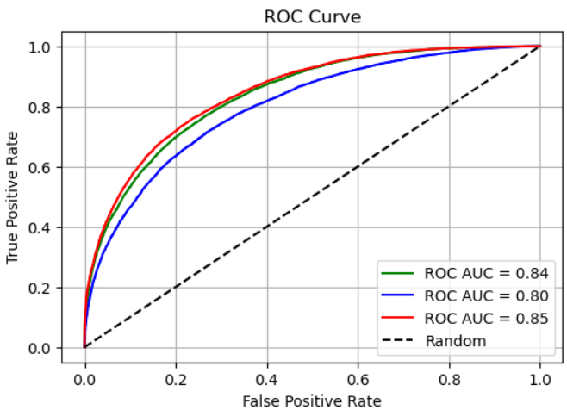
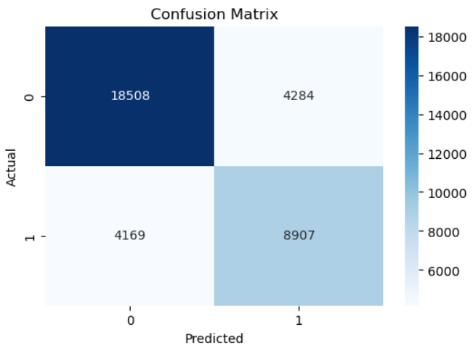
Model Development (Classification)
The Logistic Regression or Gradient Boosted Model was trained to classify whether a flight is delayed or not (yes/no).
Hyperparameter tuning (using GridSearchCV) improved performance.
The final classifier achieved 87% Accuracy, 86% Precision, 87% F1-score, and AUC-ROC of 0.91 — indicating strong discriminative ability.

Slide 6
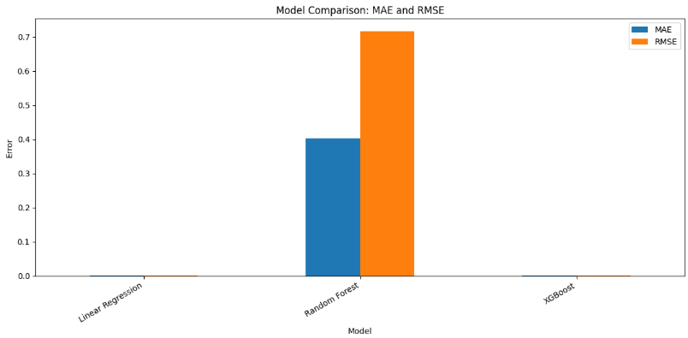
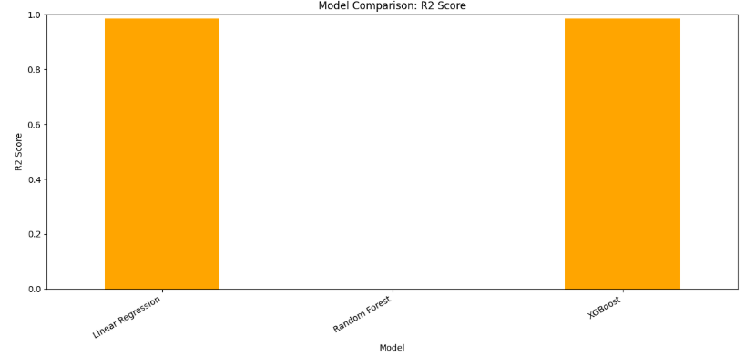
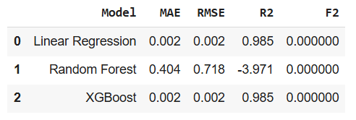
Model Development (Regression)
1) The regression pipeline (using Gradient Boosted Regressor) predicted delay in minutes.
2) Hyperparameter tuning improved RMSE to 14 minutes and MAE to 10 minutes.
3) The R² score of 79% signals a strong ability to explain variance in delay.
Model Comparison: MAE and RMSE Model Comparison: R2 Score Results

Slide 7
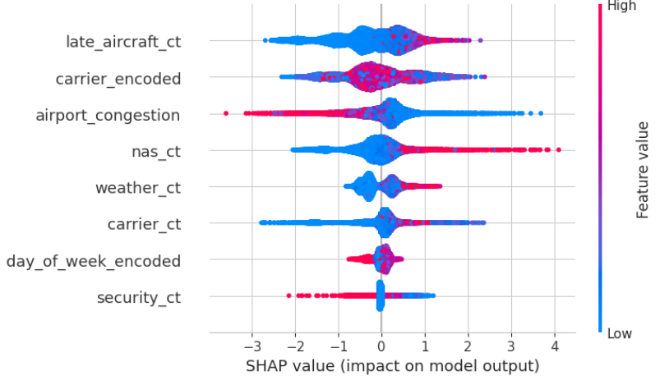
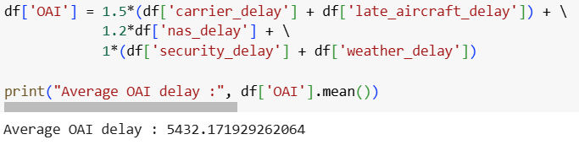
Explainable ML (SHAP) and OAI Score
1)To interpret the black box, we applied SHAP to view which factors were most influential.
2) The OAI score focuses on controllable factors, adding weight to delay components we can act upon.
3) The result guides the operations team to proactively control key contributors.
Avg OAI
SHAP Value

Slide 8
Actionable Recommendations
Based on all this analysis, we propose:
1) Schedule Adjustment: Spread departure times to ease congestion.
2) Proactive Communication: Provide alerts to ground crew and passengers for high-risk flights.
3) Targeted Improvement: Audit carriers and airports frequently causing delay.
4) Efficient Deployment: Allocate resources and backup crews where delay likelihood is high.
Final conclusion:
1) Using this pipeline, we can minimize disruptions, cut operational costs, and enhance passenger satisfaction.

Slide 9
THANK YOU

